Slide 1
Object-Oriented Progamming

Slide 2
OOP
Object-Oriented Programming (OOP) is a programming paradism based on the concept of objects, which contain data (attributes) and behavior (methods). Java is a fully object-oriented language, meaning everything in java revolves around objects and classes.
Key OOP Concepts
Concept | Description
Encapsulation | Wrapping data and methods into a single unit (class) and restricting direct access.
Abstraction | Hiding implementation details and exposing only necessary parts
Inheritance | Enabling a new class (child) to inherit properties and behaviors from an existing class (parent)
Polymorphism | Allowing methods to take different forms (method overloading and overriding).

Slide 3
Encapsulation (Data Hiding)
Encapsulation hides the internal state of an object and only exposes controlled access.
Benefits:
Prevent direct modification of data
Improves security and maintainability

Slide 4
Abstraction (Hiding Implementation)
Abstraction hides complex logic and only shows essential details. It is achieved using abstract classes or interfaces.
Benefits:
Reduces complexity
Increases code reusability

Slide 5
Inheritance (Code Reusability)
Inheritance allows one class (child) to acquire properties and behaviors of another class (parent). It helps in code reusability and follows the “is-a” relationship.
Types of inheritance in java
Single inheritance – One class inherits another
Multilevel inheritance – A class inherits from another inherited class
Hierarchical Inheritance – Multiple classes inherit from one class
Multiple Inheritance – Not allowed in java (use interaces instead).

Slide 6
Polymorphism (Method Overloading & Overriding)
Polymorphism allows one interface to be used for different types.
Method Overloading (Compile-time Polymorphism) – Same method name, different parameters in same class.
Method Overriding (Runtime Polymorphism) – A child class provides a specific implementation of a method from the parent class.

Slide 7
Polymorphism (Method Overloading & Overriding)
Difference between Overloading & Overriding
Feature | Overloading | Overriding
Definition | Same method name, different parameters | Child class modifiers parent method
When it happens? | Compile-time | Runtime
Return type | Can be different | Must be the same or a subclass
Access Modifiers | Can be changed | Can’t be more restrictive

Slide 8
SOLID PRINCIPLES
Single Responsibility
Open/Closed
Liskov Substitution
Interface Segregation
Dependency Inversion

Slide 9
SOLID Principles
The SOLID principles are a set of five design principles in object-oriented programming that help create maintainable, scalable, and flexible software. These principles were introduced by Robert C.Martin (Uncle Bob) and are widely used in OOP languages.

Slide 10
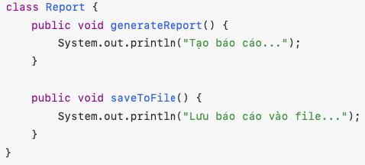
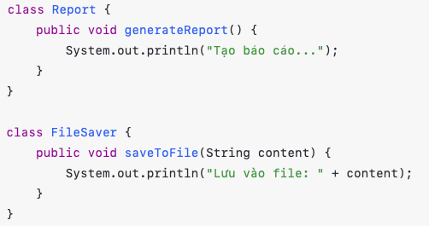
Single Responsibility Principle (SRP)
“A class should have one one reason to change.” A class should have only one responsibility and focus on a single functionality (Mỗi class chỉ nên có một trách nhiệm duy nhất).
Bad Example (Violating SRP) Good Example (Following SRP)

Slide 11
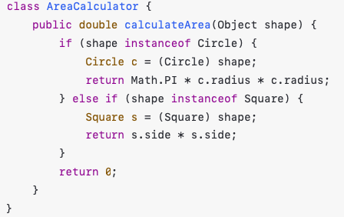
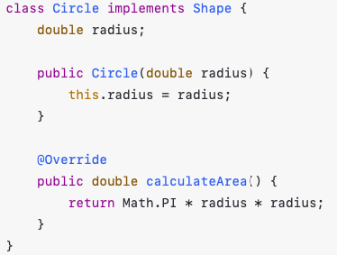
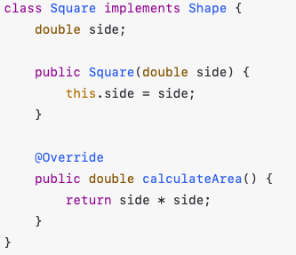
Open/Closed Principle (OCP)
“A class should be open for extension but closed for modification.” This mean you should be able to extend functionality without modifying existing code.
Bad Example (Violating OCP) Good Example (Following OCP)

Slide 12
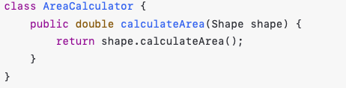
Open/Closed Principle (OCP)
We can easy add new shapes without modifying AreaCalculator

Slide 13
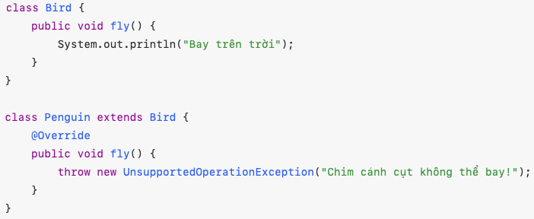
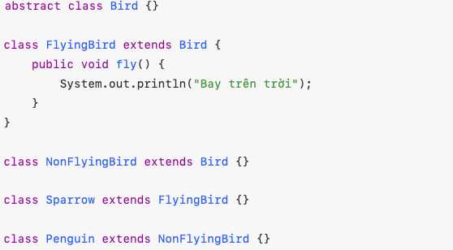
Liskov Substitution Principle (LSP)
“Subtypes must be substitutable for their base types.” A subclass should be able to replace its superclass without breaking the application. (Lớp con có thể thay thế lớp cha mà không thay đổi hành vi chương trình)
Bad Example (Violating LSP) Good Example (Following LSP)

Slide 14
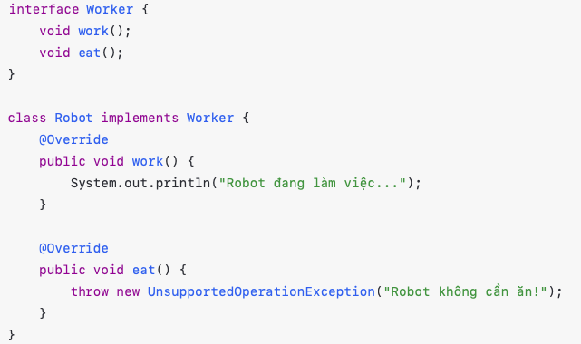
Interface Segregation Principle (ISP)
“Client should not be forced to depend on interfaces they do not use”. (Một Interface không nên ép buộc class cài đặt những phương thức không cần thiết). Instead of having one large interface, break it into smaller, specific interfaces.
Bad Example (Violating ISP)

Slide 15
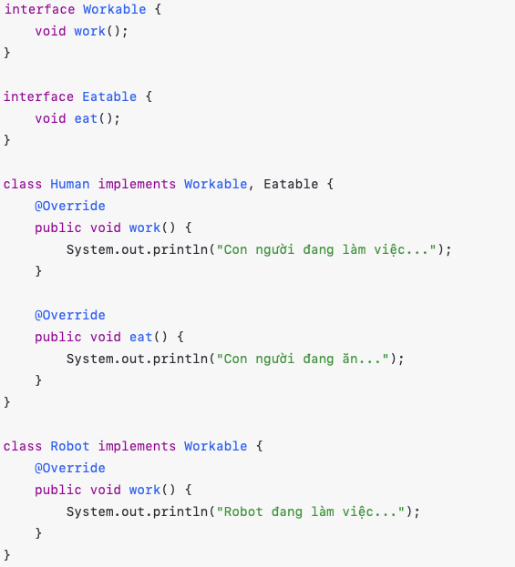
Interface Segregation Principle (ISP)
Good Example (Following ISP)

Slide 16
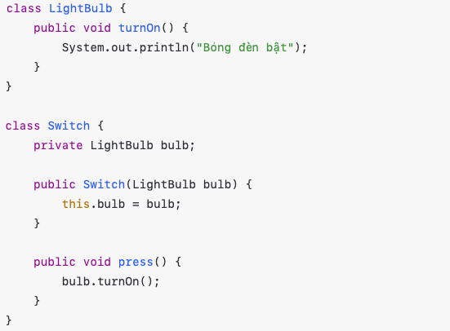
Dependency Inversion Principle (DIP)
“High-level modules should not depend on low-level modules. Both should depend on abstractions.” We should depend on interfaces instead of concrete implementations.
Bad Example (Violating DIP)

Slide 17
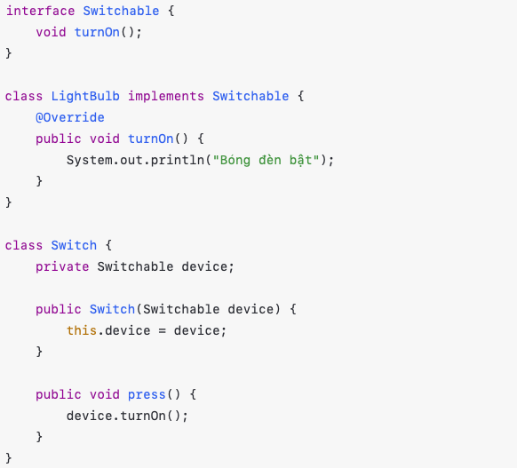
Dependency Inversion Principle (DIP)
Good Example (Following DIP)

Slide 18
Summary of SOLID Principles
Principle | Definition | Benefit
Single Responsibility | A class should have only one reason to change | Improves maintainability
Open/Closed | Classes should be open for extension but closed for modification | Increases flexibility
Liskov Substitution | Subtypes must be substitutable for their base types | Prevents unexpected behavior
Interface Segregation | Avoid large interfaces; instead, use small, specific ones | Reduce unnecessary dependencies
Dependency Inversion | Depend on abstractions, not concrete implementations | Makes code more flexible

Slide 19
Design Pattern for Software Developer

Slide 20
Agenda
What is Software Design Pattern
Types of Software Design Pattern
How to apply SDP in Programming

Slide 21
What is Software Design Pattern
Software design patterns are reusable solutions to common software design problems. They provide best practises for designing flexible, scalable and maintainable code.
Design patterns are broadly classified into three mian categories:
Creational Patterns Object creation mechanism
Structural Patterns Object composition & relationships
Behavioral Patterns Communication between objects

Slide 22
Creational Design Patterns (How objects are created)
These patterns deal with object creation mechnisms, trying to create objects in a manner that suits the situation.
Common Creational Patterns:
Singleton: Ensures only one instance of a class exists and provides a global access point.
Factory Method: Defines an interface for creating an object, but allows subclasses to alter the type of object that will be created.
Abstract Factory: A factory of factories; creates families of related object without specifying their concrete classes
Builder: Allows the step-by-step construction of complex objects.
Prototype: Create new objects by copying an existing object instead of instantiating from scrash

Slide 23
Creational Design Patterns (How objects are created)
Example:
Singleton: Database connection instance
Factory Method: Logger class that generates different log types
Builder: Create complex HTML document etc.

Slide 24
Structural Design Patterns (How objects are structured)
These patterns deal with object composition and typically help ensure that if one part of a system changes, the entire system does not need to do the same.
Common Structural Patterns
Adapter: Allows incompatible interfaces to work together.
Bridge: Decouples abstraction from implementation so they change independently.
Composite: Allows treating a group of objects as a single instance of an object.
Decorator: Adds new functionality to an object dynamically
Facade: Provide a simplified interface to complex system.
Flyweight: Reduces memory usage by sharing objects instead of creating new ones.
Proxy: Provides a surrogate or placeholder for another object to control access to it.

Slide 25
Structural Design Patterns (How objects are structured)
Example:
Adapter: Connecting a legacy API with a new system
Facade: Simplifying access to a complex library (eg: a video player library)
Decorator: Adding extra behavior to UI components dynamically

Slide 26
Behavioral Design Patterns (How objects interact)
These patterns are concerned with object interaction and responsibility distribution. They help objects communicate effectively while maintaining loose coupling.
Common Behavioral Patterns
Chain of responsibility: Passes a request along a chian of handlers.
Command: Encapsulates a request as an object, allowing parameterization of clients with requests.
Interpreter: Defines a grammatical representation for a language and an interpreter to interpret the grammar.
Interator: Provides a way to access elements of a collection sequentially without exposing its structure.

Slide 27
Behavioral Design Patterns (How objects interact)
Mediator: Reduces dependencies between object by centralizing communication.
Memento: Captures and restores an object’s state without exposing its details.
Observe: Defines a one-to-many dependency so when one object changes, others are notifies.
State: Allow an object to change its behavior when its internal state changes.
Strategy: Encapsulates interchangeable behaviors and uses them based on the situation.
Template Method: Defines the skeleton of an algorithm but lets subclasses fill in the details.
Visitor: Allows adding new operations to objects without modifying them.

Slide 28
Behavioral Design Patterns (How objects interact)
Example:
Observer: Publish-subscribe mechanism in event-driven systems.
Stratery: Payment methods (credit card, paypal, bitcoin)
Command: Undo/redo system in text editors

Slide 29
Choosing the Right Design Pattern
Use Creational Pattern when you need flexible and reusable object creation mechanisms.
Use Structural Patterns when dealing with relationships between entities to make the system more flexible and scalable.
Use Behavioral Patterns when you need to manage object communication efficiently and maintain a clear responsibility separation.
Real-world Analogy:
Creational Patterns -> “How do I make a car?” (Factory makes different types of cars)
Structural Patterns -> “How do I assemble the car?” (Bridges, adapter, etc).
Behavioral Pattterns -> “How does the car behave?” (Observer for sensors, Strategy for driving mode)

Slide 30
Singleton Design Pattern
Creational Design Patterns

Slide 31
Singleton Design Patterns (Creational Design Patterns)
The Singleton Pattern is a Creational Design Pattern that ensures a class has only one instance and provides a global access point to it.
Why use Singleton Pattern?
Controlled access to a single instance – Prevents multiple object creation.
Saves memory - Especially useful for heavy resources like database connections.
Encapsulated global state – Centralized management of shared data.
Thread-safety – Ensures multiple threads access the same instance safety.

Slide 32
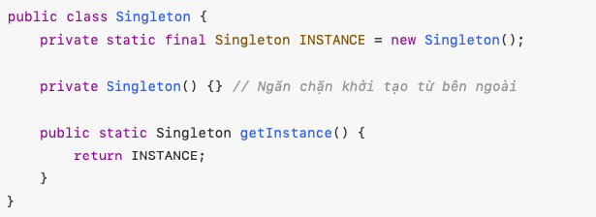
Singleton Design Patterns (Creational Design Patterns)
There are multiple ways to implement Singleton in Java:
Eager Initialization (Thread-Safe but not Lazy)
Pros: Simple, thread-safe
Cons: Object is created even if not needed (wastes memory)

Slide 33
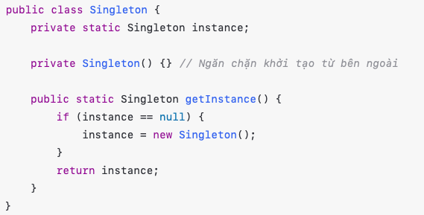
Singleton Design Patterns (Creational Design Patterns)
2. Lazy Initialization (Not Thread-Safe)
Pros: Saves memory, instance created only when required
Cons: Not thread-safe, multiple threads may create multiple instance

Slide 34
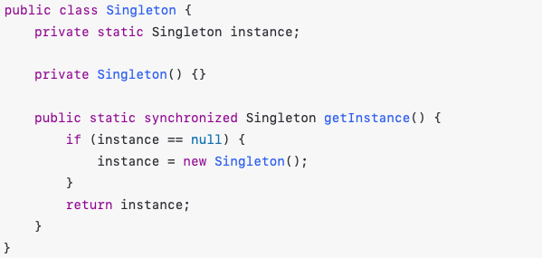
Singleton Design Patterns (Creational Design Patterns)
3. Thread-Safe Singleton (Synchronized Method)
Pros: Thread-safe
Cons: Synchoronization slows down performance

Slide 35
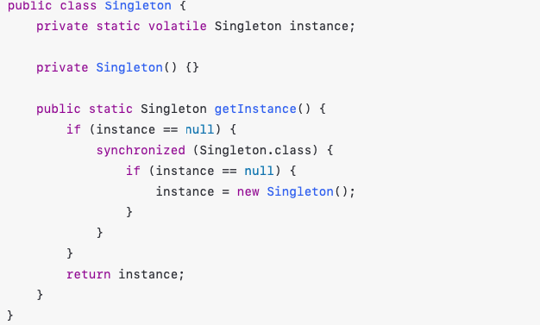
Singleton Design Patterns (Creational Design Patterns)
4. Double-Checked Locking (Efficient & Thread-Safe)
Pros: Efficient and thread-safe
Cons: Slightly complex

Slide 36
Singleton Design Patterns (Creational Design Patterns)
5. Bill Pugh Singleton (Best Approach)
Pros: Efficient and thread-safe
Cons: Slightly complex

Slide 37
Singleton Design Patterns (Creational Design Patterns)
4. Double-Checked Locking (Efficient & Thread-Safe)
Uses an inner static helper class.
Pros: Thread safe without synchronization. Lazy-loaded only when leeded. Best performance

Slide 38
Factory Method
Creational Design Pattern

Slide 39
Factory Method Design Patterns (Creational Design Patterns)
The Factory Pattern is Creational Design Pattern that defines an interface for creating objects but allows subclasses to decide which class to instantiate
Why use the Factory Method Pattern?
Encapsulation – Hide object creation logic from the client.
Flexibility – New types can be added without modifying existing code.
Loose Coupling – The client depends on an interface, not concrete implementations.
Encourages OOP Principles – Follows the Open-Closed Principle (OCP) by allowing extention without modification.

Slide 40
Factory Method Design Patterns (Creational Design Patterns)

Slide 41
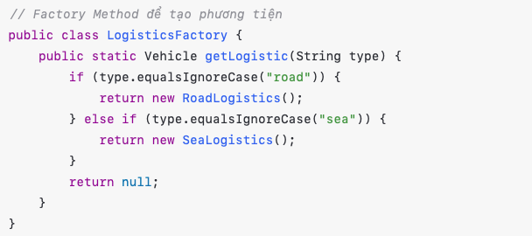
Factory Method Design Patterns (Creational Design Patterns)

Slide 42
Abstract Factory
Creational Design Pattern

Slide 43
Abstract Factory Design Patterns (Creational Design Patterns)
Abstract Factory is a Creational Design Pattern that provides an interface for creating families of related without spefifying their concrete classes.
It is useful when:
You need to create multiple related objects.
You want to enforce a spefific group of objects together
You want to decouple object creation from its usage.

Slide 44
Abstract Factory Design Patterns (Creational Design Patterns)

Slide 45
Abstract Factory Design Patterns (Creational Design Patterns)

Slide 46
Abstract Factory Design Patterns (Creational Design Patterns)

Slide 47
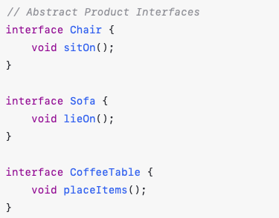
Abstract Factory Design Patterns (Creational Design Patterns)
1. Define Common Interfaces for Products
We have three types of furniture: Chair, Sofa, and Coffee Table.
Each type has three styles: Art Deco, Victorian, and Modern.

Slide 48
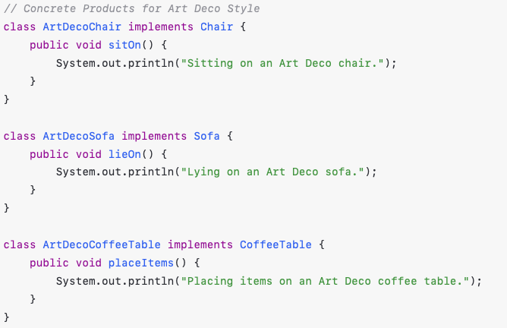
Abstract Factory Design Patterns (Creational Design Patterns)

Slide 49
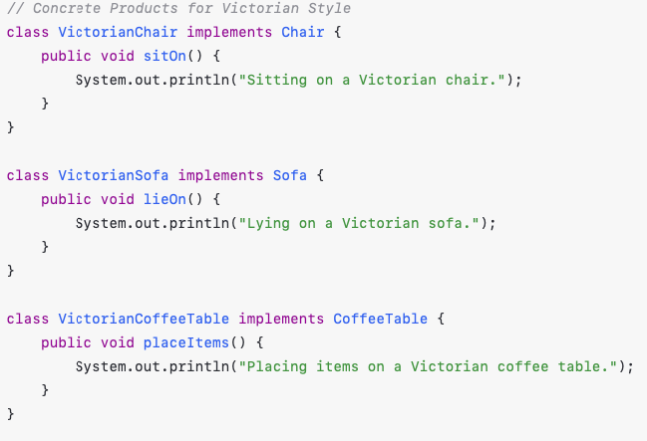
Abstract Factory Design Patterns (Creational Design Patterns)

Slide 50
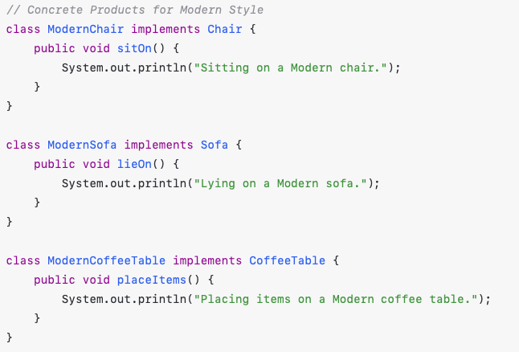
Abstract Factory Design Patterns (Creational Design Patterns)

Slide 51
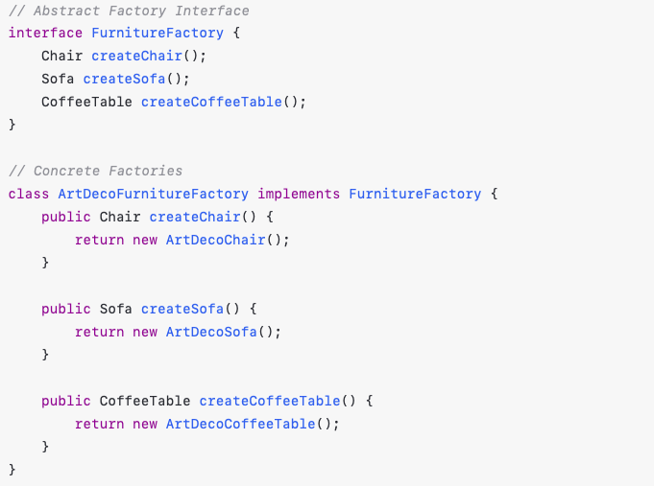
Abstract Factory Design Patterns (Creational Design Patterns)

Slide 52
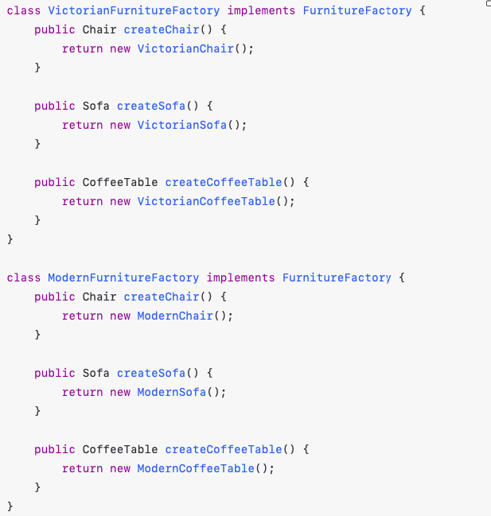
Abstract Factory Design Patterns (Creational Design Patterns)

Slide 53
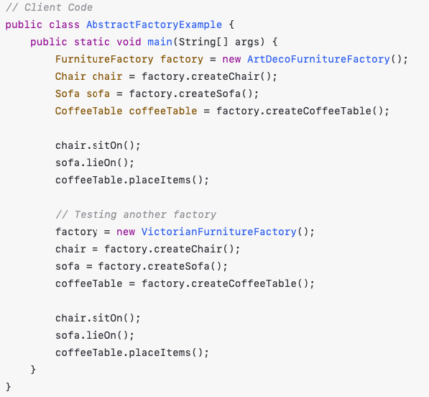
Abstract Factory Design Patterns (Creational Design Patterns)

Slide 54
Builder Pattern
Creational Design Pattern

Slide 55
Builder Design Patterns (Creational Design Patterns)
The Builder Pattern is a Creational Design Pattern that separates object construction from its representation, allowing you to create complex objects step by step.
Why use the builder pattern?
Handles Complex Object Construction – Useful when an object has multiple fields, optional parameters, or different configurations.
Readable & Maintainable Code – Improves clarity by removing long constructors with multiple parameters.
Immutable Objects – Helps in creating immutable objects (e.g., StringBuilder, Lombok @Builder).
Follow SOLID Principles – Single Responsibility Principle by separating object creation logic.

Slide 56
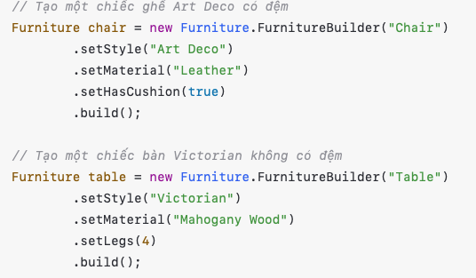
Builder Design Patterns (Creational Design Patterns)

Slide 57
Prototype
Creational Design Pattern

Slide 58
Prototype Design Patterns (Creational Design Patterns)
The Prototype Pattern is a Creational Design Pattern that allows cloning objects instead of creating new ones from scratch. This pattern is useful when object creation is expensive or complex.
Why use the Protorype Pattern?
Improves Performance – Cloning is faster than creating a new object.
Reduces Complexity – Avoids subclassing or complex constructors.
Preserves Object State – Cloned objects retain the state of the original.
Follow the Open-Closed Principle (OCP) – Allows extending objects without modifying existing code.

Slide 59
Prototype Design Patterns (Creational Design Patterns)
To implement Prototype Pattern, we can use Deep Copy or Shallow Copy by use Java provides a built-in Cloneable interface and clone() method in the object class.

Slide 60
Adapter Design Pattern
Structural Patterns

Slide 61
Adapter Design Pattern
The Adapter Pattern is a Structural Design Pattern that allows two incompatible interface to work together by acting as a bridge between them.
Why use the Adapter Pattern?
Bridges Incompatible Interfaces – Allows old and new code to work together.
Enhances Code Reusability – Enables using existing classes without modifying them.
Allow Open-Closed Principle (OCP) – Allows extending functionality without altering existing code.
Improves Flexibility – Adapts third-party libraries or legacy code to fit new requirements.

Slide 62
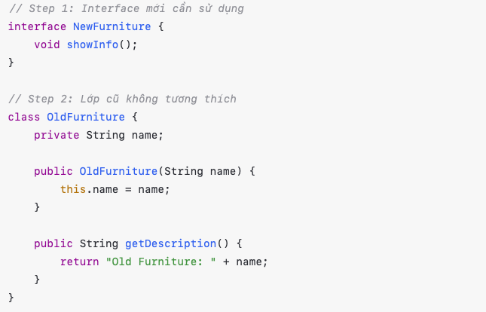
Adapter Design Pattern

Slide 63
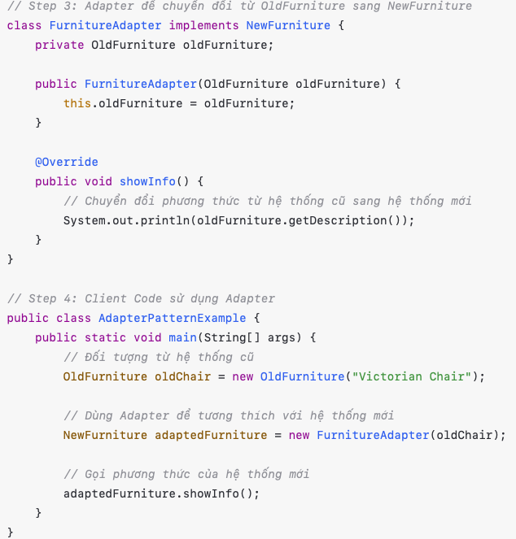
Adapter Design Pattern

Slide 64
Bridge Design Pattern
Structural Patterns

Slide 65
Bridge Design Pattern
The Bridge Pattern is a Structural Design Pattern that decouples abstraction from implementation so that they can evolve independently.
It helps avoid tigh coupling between components and allows more flexibility in extending functionalities
Why use the Bridge Pattern?
Decouples abstracton from implementation – Helps in separating the “what” from the “how”.
Improves scalibility – New implementations can be added without modifying existing code.
Allow Open-Closed Principle (OCP) – Allows extending functionality without altering existing code.
Avoids Class Explosion – Prevent a large number of subclasses when combining multiple functionalities.

Slide 66
Bridge Design Pattern

Slide 67
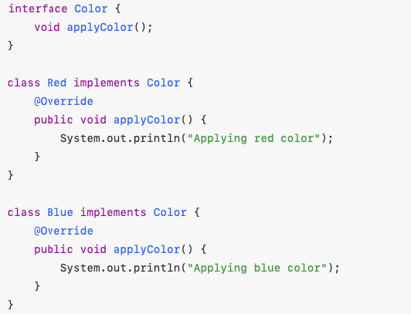
Bridge Design Pattern
Color (Bridge)

Slide 68
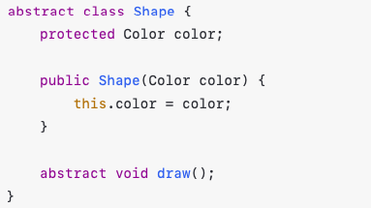
Bridge Design Pattern
Abstraction - Shape

Slide 69
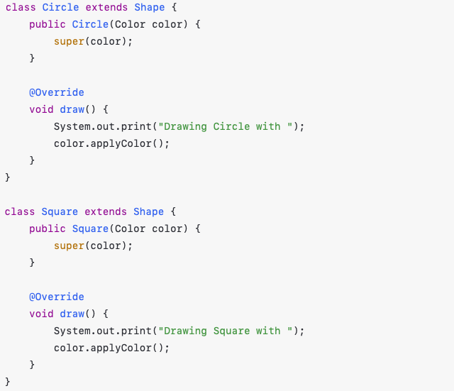
Bridge Design Pattern
Concrete Abstraction – Specific Shape

Slide 70
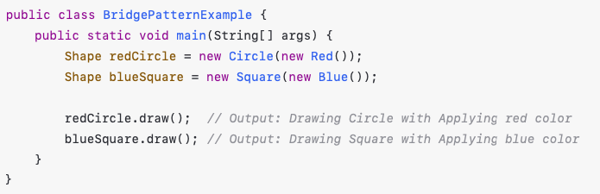
Bridge Design Pattern
Client Code

Slide 71
Bridge Design Pattern
Giải thích Bridge Pattern trong ví dụ:
Tách rời phần “Hình dạng” và “Màu sắc” giúp mở rộng độc lập
Hình dạng (Shape) có thể thay đổi mà không ảnh hưởng tới cách tô màu
Màu dắc (Color) có thể thêm mới mà không sửa đổi lớp hình dạng.
Dễ mở rộng: Nếu có thêm màu mới, chỉ cần tạo lớp mới mà không thay đổi Shape.
Cách tiếp cận này giúp tránh tình trạng kế thừa chồng chất khi có nhiều hình dạng và màu sắc!

Slide 72
Composite Design Pattern
Structural Patterns

Slide 73
Composite Design Pattern
Composite Pattern là một design pattern thuộc nhóm Cấu trúc (Structural Pattern), cho phép gộp nhiều đối tượng thành một cấu trúc cây, giúp xử lý các nhóm đối tượng và đối tượng đơn lẻ theo cách thống nhất.
Khi nào nên dùng Composite Pattern?
Khi cần thể hiện cấu trúc cây (tree structure).
Khi muốn xử lý các đối tượng đơn lẻ và nhóm đối tượng theo
cách giống nhau

Slide 74
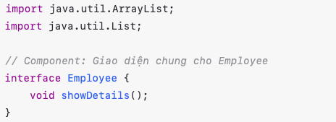
Composite Design Pattern
Ví dụ: Một hệ thống quản lý nhân sự với nhân viên bình thường (Employee) và trưởng phòng (Manager) có thể chứa nhiều nhân viên khác.
Step 1: Tạo Interface Component (thành phần chung)

Slide 75
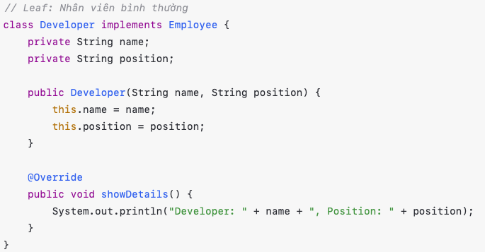
Composite Design Pattern
Step 2: Tạo lớp Leaf (lá) - Nhân viên bình thường

Slide 76
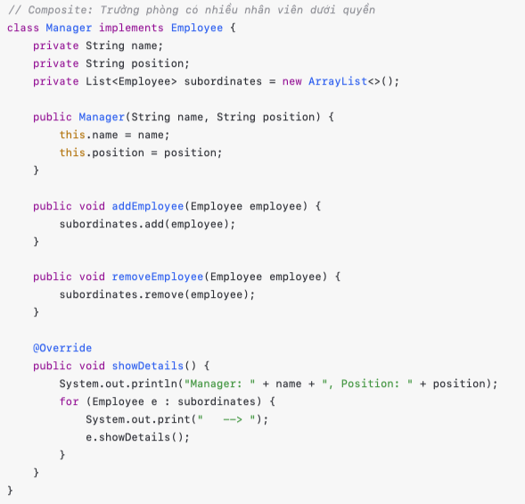
Composite Design Pattern
Step 3: Tạo lớp Composite – Trưởng phòng có nhiều nhân viên cấp dưới

Slide 77
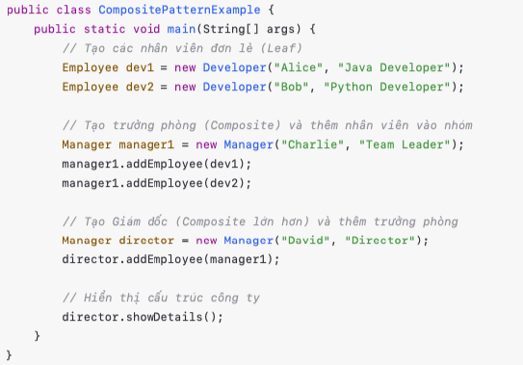
Composite Design Pattern
Step 4: Client App

Slide 78
Decorator Design Pattern
Structural Patterns

Slide 79
Decorator Design Pattern
Decorator Pattern là một Design Pattern thuộc nhóm Structural Pattern, cho phép mở rộng chức năng của một đối tượng mà không thay đổi mã nguồn của nó.
Khi nào dùng Decorator Pattern?
Khi cần thêm/chỉnh sửa chức năng cho một lớp mà không sửa đổi trực tiếp lớp gốc.
Khi muốn tránh kế thừa nhiều lớp con, vì Decorator sử dụng thành phần (composition) thay vì kế thừa.
Ví dụ thực tế:
Cà phê có thể thêm đường, sữa, kem … mà không thay đổi lớp coffee gốc.

Slide 80
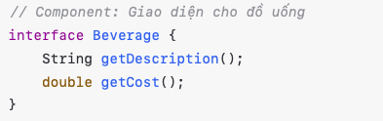
Decorator Design Pattern
Step 1: Tạo Interface Component (Common)

Slide 81
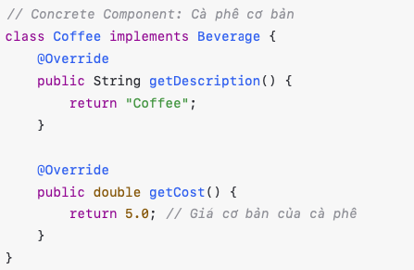
Decorator Design Pattern
Step 2: Tạo class Concrete Component

Slide 82
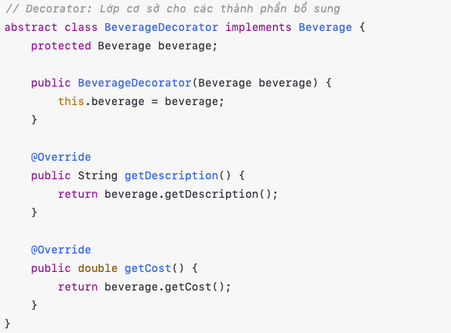
Decorator Design Pattern
Step 3: Tạo class Decorator

Slide 83
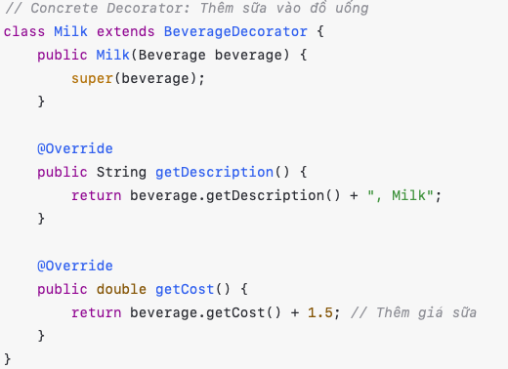
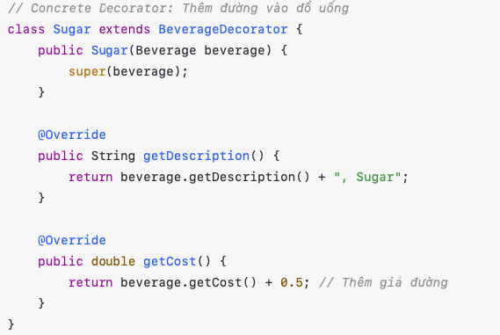
Decorator Design Pattern
Step 4: Tạo class Concrete Decorator (Thêm chức năng)

Slide 84
Facade Design Pattern
Structural Patterns

Slide 85
Facade Design Pattern
Facade Pattern là một design pattern thuộc nhóm Structural Pattern, chung cấp một giao diện đơn giản (Facade) để truy cập các hệ thống con phức tạp.
Khi nào dùng Facade Pattern?
Khi hệ thống có nhiều lớp con hoặc API phức tạp, cần một lớp trung gian đơn giản để tương tác.
Khi muốn giảm sự phụ thuộc giữa các lớp và ẩn bớt sự phức tạp của hệ thống con.
Khi cần tạo một giao diện cấp cao hơn để dễ sử dụng hơn

Slide 86
Facade Design Pattern
Ví dụ thực tế:
Hệ thống đặt vé máy bay: Người dùng chỉ cần gọi một hàm thay vì thao tác với nhiều hệ thống.
API Ngân hàng: Facade giúp ẩn đi nhiều bước xác thực, kiểm tra số dư, xử lý giao dịch

Slide 87
Facade Design Pattern

Slide 88
Flyweight Design Pattern
Structural Patterns

Slide 89
Flyweight Design Pattern
Flyweight Pattern là một mẫu thiết kế (Design pattern) thuộc nhóm Structural Pattern, giúp giảm thiểu việc sử dụng bộ nhớ bằng cách chia sẻ đối tượng giống nhau thay vì tạo mới liên tục.
Khi nào dùng Flyweight Pattern?
Khi ứng dụng tạo ra quá nhiều đối tượng giống nhau, gây tốn bộ nhớ.
Khi cần tối ưu hiệu suất và giảm chi phí bộ nhớ bằng cách dùng object pool (bộ nhớ đệm đối tượng).
Khi có nhiều đối tượng có thể tái sử dụng thay vì tạo mới mỗi lần.

Slide 90
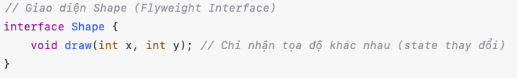
Flyweight Design Pattern
Ví dụ: Một ứng dụng vẽ hình tròn (Circle) trên màn hình.
Mỗi hình tròn có màu sắc giống nhau có thể được tái sử dụng để tiết kiệm bộ nhớ.
Các thuộc tính khác biệt như tạo độ x, y, bán kính được xử lý bên ngoài.
Step 1: Tạo Interface Flyweight

Slide 91
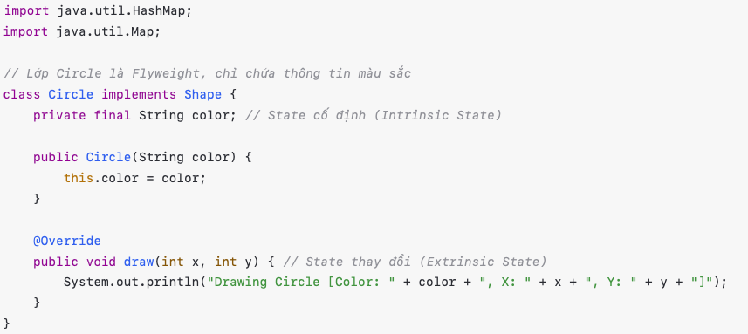
Flyweight Design Pattern
Step 2: Tạo lớp Flyweight (Hình tròn)

Slide 92
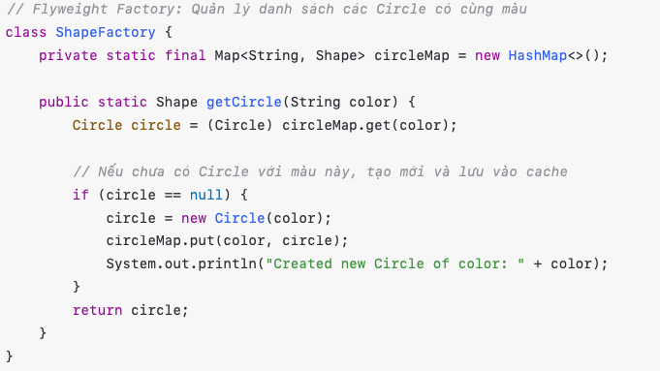
Flyweight Design Pattern
Step 3: Tạo lớp Flyweight Factory để quản lý đối tượng tái sử dụng

Slide 93
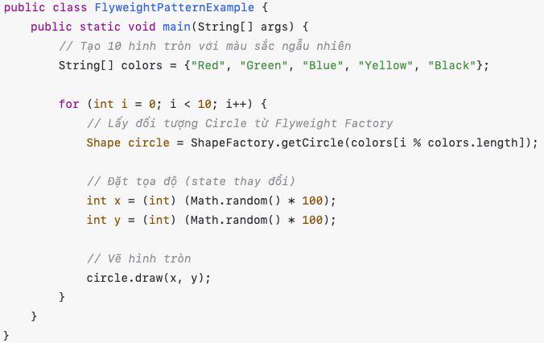
Flyweight Design Pattern
Step 4: Test Client

Slide 94
Proxy Design Pattern
Structural Patterns

Slide 95
Proxy Design Pattern
Proxy Pattern là một mẫu thiết kế thuộc nhóm Structural Pattern, giúp kiểm soát việc truy cập đến một đối tượng khác bằng cách sử dụng một lớp Proxy thay mặt nó.
Khi nào dùng Proxy Pattern?
Khi cần kiểm soát quyền truy cập đến một đối tượng, chẳng hạn như hạn chế người dùng chưa xác thực.
Khi cần tăng hiệu suất bằng cách lazy initialization (khởi tạo khi cần thiết).
Khi muốn thêm bảo mật, như kiểm tả quyền truy cập trước khi gọi một phương thức.
Khi muốn ghi log hoặc caching trước khi thực sự gọi đến một đối tượng chính

Slide 96
Proxy Design Pattern
Các loại Proxy phổ biến:
Virtual Proxy: Tạo đối tượng khi thực sự cần.
Protection Proxy: Kiểm soát quyền truy cập.
Remote Proxy: Truy cập đối tượng từ xa.
Cache Proxy: Lưu trữ dữ liệu tạm thời để giảm tải hệ thống.
Smart Proxy: Thêm tính năng như Logging, đo thời gian thực thi.

Slide 97
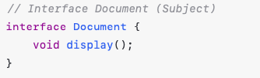
Proxy Design Pattern
Ví dụ: Kiểm soát quyền truy cập vào một tài liệu PDF (Protection Proxy)
Lớp RealDocument xử lý tài liệu PDF thật
Lớp ProxyDocument kiểm tra quyền truy cập trước khi cho phép đọc tài liệu.
Step 1: Tạo Interface chung

Slide 98
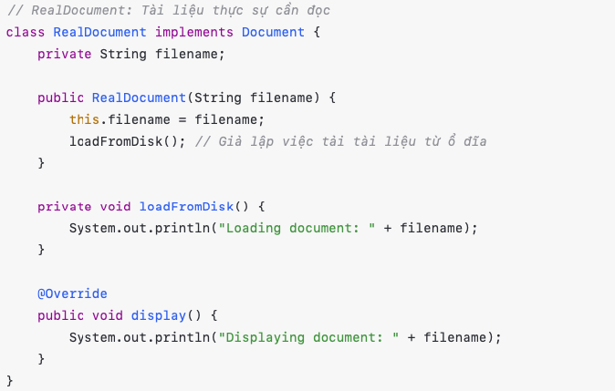
Proxy Design Pattern
Step 2: Tạo lớp RealDocument

Slide 99
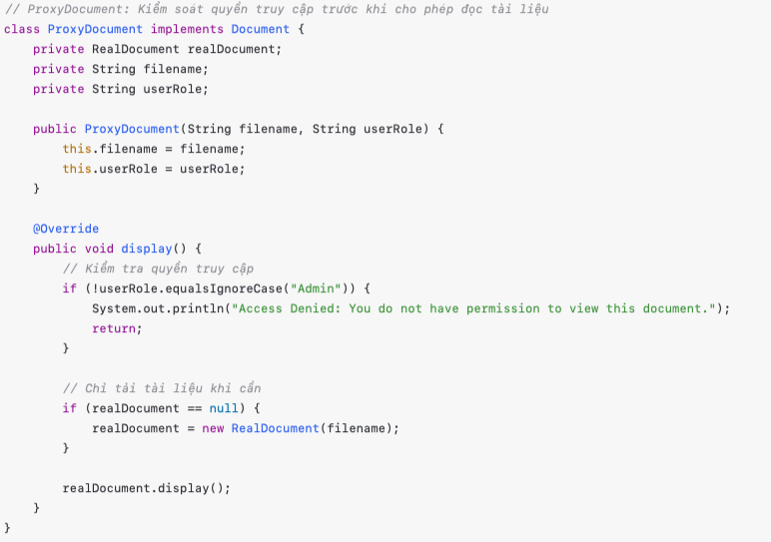
Proxy Design Pattern
Step 3: Tạo lớp ProxyDocument (Proxy)

Slide 100
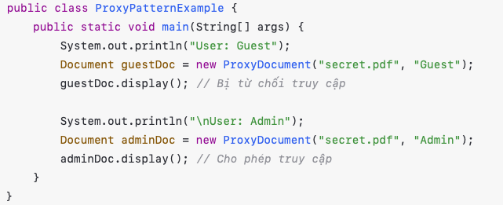
Proxy Design Pattern
Step 4: Client App

Slide 101
Chain of Responsibility Design Pattern
Behavioral Pattern

Slide 102
Chain of Responsibility Design Pattern
Chain of Responsibility Pattern là một mẫu thiết kế thuộc nhóm Behavioral Pattern, cho phép một chuỗi các đối tượng xử lý yêu cầu mà không cần biết đối tượng nào sẽ xử lý.
Khi nào dùng Chain of Responsibility Pattern?
Khi có nhiều đối tượng có thể xử lý một yêu cầu, nhưng không biết trước đối tượng nào sẽ xử lý.
Khi muốn giảm sự phụ thuộc (coupling) giữa người gửi yêu cầu và người xử lý.
Khi muốn xử lý các yêu cầu theo chuỗi có thể mở rộng, dễ bảo trì.

Slide 103
Chain of Responsibility Design Pattern
Ví dụ thực tế:
Xử lý yêu cầu hỗ trợ khách hàng: Nếu nhân viên hỗ trợ không thể xử lý, sẽ chuyển lên cấp cao hơn.
Hệ thống logger: Log có thể được ghi ở nhiều mức như Debug -> Info -> Warning -> Error.
Phê duyệt chi phí: Nhân viên gửi yêu cầu, nếu quá mức, sẽ được chuyển lên cấp trên.

Slide 104
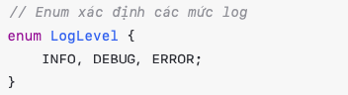
Chain of Responsibility Design Pattern
Ví dụ: Cài đặt hệ thống xử lý mức độ Log (INFO, DEBUG, ERROR)
Mỗi mức Log sẽ được một hanlder xử lý.
Nếu handler hiện tại không xử lý, nó sẽ chuyển lên cấp cao hơn.
Step 1: Tạo Enum LogLevel

Slide 105
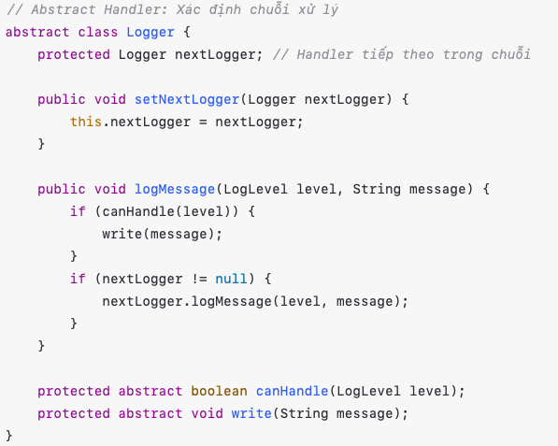
Chain of Responsibility Design Pattern
Step 2: Tạo Abstract class Handler (Base Handler)

Slide 106

Chain of Responsibility Design Pattern
Step 3: Tạo Các logger cụ thể
ConsoleLogger (Xử lý mức INFO)

Slide 107

Chain of Responsibility Design Pattern
Step 3: Tạo Các logger cụ thể
FileLogger (Xử lý mức DEBUG)

Slide 108

Chain of Responsibility Design Pattern
Step 3: Tạo Các logger cụ thể
ErrorLogger (Xử lý mức ERROR)

Slide 109

Chain of Responsibility Design Pattern
Step 4: Cấu hình Chain of Responsibility và chạy thử

Slide 110
Chain of Responsibility Design Pattern
Lợi ích của Chain of Responsibility Pattern:
Giảm sự phụ thuộc giữa nơi gửi và nơi xử lý
Dễ dàng mở rộng bằng cách thêm handler mới
Tăng khả năng tái sử dụng do các Handler có thể kết hợp linh hoạt.

Slide 111
Iterator Design Pattern
Behavioral Pattern

Slide 112
Iterator Design Pattern
Iterator Pattern là một mẫu thiết kế thuộc nhóm Behavioral Pattern, cung cấp cách truy cập tuần tự đến các phần tử trong một tập hợp (collection) mà không biết cấu trúc lưu trữ của nó.
Khi nào dùng Iterator Pattern?
Khi cần duyệt qua các phần tử của một tập hợp mà không làm lộ cấu trúc bên trong.
Khi muốn cung cấp nhiều cách duyệt khác nhau (ví dụ: duyệt xuôi, ngược, theo điều kiện v.v…)
Khi tập hợp có thể thay đổi cấu trúc nhưng vẫn muốn duyệt qua nó một cách linh hoạt

Slide 113
Mediator Design Pattern
Behavioral Pattern

Slide 114
Mediator Design Pattern
Mediator Pattern là một mẫu thiết kế thuộc nhóm Behavioral Pattern, giúp giảm sự phụ thuộc trực tiếp giữa các đối tượng bằng cách giới thiệu một đối tượng trung gian (Mediator) để xử lý giao tiếp giữa chúng
Khi nào dùng Mediator Pattern?
Khi có nhiều đối tượng cần giao tiếp với nhau, nhưng muốn tránh sự phụ thuộc trực tiếp lẫn nhau.
Khi hệ thống có quá nhiều kết nối giữa các đối tượng (mạng lưới phức tạp), gây khó khăn cho việc bảo trì.
Khi cần kiểm soát luồng giao tiếp giữa các đối tượng theo một quy tắc cụ thể.

Slide 115
Mediator Design Pattern
Ví dụ thực tế:
Trung tâm điều phối không lưu (Air Traffic Control – ATC): Các máy bay không liên lạc trực tiếp với nhau mà thông qua tháp kiểm soát.
Chat Room: Người dùng không liên lạc trực tiếp mà qua một hệ thống trung gian.

Slide 116
Mediator Design Pattern
Ví dụ: Ứng dụng Chat Room
Mediator trung gian giúp các người dùng trong chat room có thể gửi tin nhắn cho nhau mà không cần biết chi tiết về nhau.
User là thành viên trong phòng chat.
ChatRoom là lớp thực hiện Mediator để quản lý tin nhắn.

Slide 117

Mediator Design Pattern
Step 1: Tạo giao diện Mediator
sendMessage() giúp gửi tin nhắn từ một User đến các User khác
addUser() để thêm người dùng mới vào phòng chat.

Slide 118

Mediator Design Pattern
Step 2: Tạo lớp ChatRoom (Mediator)
Users lưu danh sách người dùng trong phòng chat
sendMessage() gửi tin nhắn đến tất cả người dùng ngoại trừ người gửi

Slide 119

Mediator Design Pattern
Step 3: Tạo lớp User (Người dùng trong phòng chat)
User có tham chiếu đến ChatMediator để gửi và nhận tin nhắn
Send() dùng để gửi tin nhắn
Receive() nhận tin nhắn từ người khác.

Slide 120

Mediator Design Pattern
Step 4: Tạo lớp User cụ thể

Slide 121

Mediator Design Pattern
Step 5: Client App

Slide 122

Memento Design Pattern
Behavioral Pattern

Slide 123
Memento Design Pattern
Memento Pattern là một trong những mẫu thiết kế thuộc nhóm Behavioral (hành vi). Nó cho phép lưu trữ trạng thái của một đối tượng để có thể khôi phục lại sau này mà không vi phạm tính đóng gói (Encapsulation).
Khi nào nên dùng Mamento Pattern?
Khi cần khôi phục trạng thái trước đó của một đối tượng.
Khi cần hỗ trợ chức năng “Undo” hoặc “Redo”.
Khi muốn giữ lịch sử trạng thái của đối tượng màk hông ảnh hưởng đến nó.

Slide 124
Memento Design Pattern
Design pattern này gồm 3 thành phần chính.
Originator: Đối tượng gốc cần lưu trữ trạng thái
Memento: Đối tượng lưu trữ trạng thái của Originator
Caretaker: Quản lý các bản ghi nhớ (Memento) và chịu trách nhiệm khôi phục trạng thái khi cần.
Ví dụ: Minh hoạ cách sử dụng Memento Pattern để lưu trữ và khôi phục trạng thái của một tài liệu (Document).

Slide 125

Memento Design Pattern
Step 1: Tạo Class Memento để lưu trữ trạng thái

Slide 126

Memento Design Pattern
Step 2: Tạo lớp Originator để quản lý trạng thái

Slide 127

Memento Design Pattern
Step 3: Tạo lớp Caretaker để lưu trữ các Memento

Slide 128

Memento Design Pattern
Step 4: Kiểm thử Memento Pattern

Slide 129
Observer Design Pattern
Behavioral Pattern

Slide 130
Observer Design Pattern
Observer Pattern là một mẫu thiết kế thuộc Behavioral Pattern, cho phép một đối tượng (subject) tự động thông báo đến một danh sách các đối tượng khác (Observers) khi có sự thay đổi trạng thái.
Khi nào nên dùng Observer Pattern?
Khi một thay đổi trong đối tượng cần được tự động phản ánh ở nhiều đối tượng khác.
Khi có mối quan hệ một-nhiều giữa các đối tượng (one-to-many dependency).
Khi muốn giảm sự phụ thuộc chặt chẽ giữa các đối tượng (loose coupling).

Slide 131
Observer Design Pattern
Ví dụ thực tế:
Hệ thống thông báo (Notification System): Khi có một bài viết mới, tất cả người đăng ký (subscribers) sẽ nhận được thông báo.
Mô hình Publisher-Subscriber trong các hệ thống nhắn tin (RabbitMQ, Kafka).
Mô hình Event-Listener trong GUI (Java Swing, Android).

Slide 132

Observer Design Pattern
Cài đặt Observer Pattern: Hệ thống thông báo Youtube
Subject (Observerable) là kênh Youtube, khi có video mới, nó sẽ thông báo cho tất cả người đăng ký.
Observer là người dùng (Subscribers), họ sẽ nhận thông báo khi có video mới.
Step 1: Tạo Interface Observer
update() sẽ gọi khi có video mới

Slide 133

Observer Design Pattern
Step 2: Tạo interface Subject (Observable)
subscribe() để thêm người đăng ký.
unsubscribe() để xoá người đăng ký.
notifyObservers() để thông báo video mới.

Slide 134

Observer Design Pattern
Step 3: Tạo class YouTubeChannel (Concrete Subject)

Slide 135

Observer Design Pattern
Step 4: Tạo class Subscriber(Concrete Observer)

Slide 136

Observer Design Pattern
Step 5: Test App

Slide 137
State Design Pattern
Behavioral Pattern

Slide 138
State Design Pattern
State Pattern là một mẫu thiết kế thuộc nhóm Behavioral Pattern, cho phép một đối tượng thay đổi hành vi của mình khi trạng thái của nó thay đổi. Mẫu này giúp đối tượng thay đổi hành vi mà không cần phải sử dụng các cấu trúc điều kiện phức tạp (if-else, switch-case).
Khi nào nên dùng State Pattern?
Khi một đối tượng có thể có nhiều trạng thái và hành vi của đối tượng phụ thuộc vào trạng thái hiện tại.
Khi muốn tách biệt các hành vi khác nhau vào các lớp riêng biệt, làm cho mã nguồn dễ bảo trì và mở rộng hơn.
Khi trạng thái của đối tượng có thể thay đổi dynamically trong suốt vòng đời của đối tượng.

Slide 139
State Design Pattern
Ví dụ thực tế:
Trình điều khiển máy in: Máy in có thể ở các trạng thái như Ready, Printing, Error
Máy bán hàng tự động: có thể ở trạng thái Có tiền, Không có tiền, Đang phục vụ.
Máy nghe nhạc: Có thể ở trạng thái như Playing, Paused, Stopped

Slide 140
State Design Pattern
Cấu trúc State Pattern bao gồm các thành phần chính:
Context: Đối tượng chính chứa trạng thái hiện tại và uỷ quyền hành vi cho trạng thái này.
State (Interface hoặc Abstract Class): Định nghĩa một giao diện chung cho tất cả các trạng thái cụ thể.
Concrete State: Các lớp cụ thể triển khai giao diện State, mỗi lớp đại diện cho một trạng thái của Context.

Slide 141

State Design Pattern
Ví dụ: Giả sử chúng ta có một máy bán hàng tự động (Vending Machine) với ba trạng thái:
NoCoinState: Chưa có tiền xu.
HasCoinState: Đã có tiền xu.
DispensingState: Đang phát sản phẩm.
Step 1: Tạo interface State

Slide 142

State Design Pattern
Step 2: Tạo các lớp trạng thái cụ thể

Slide 143

State Design Pattern
Step 2: Tạo các lớp trạng thái cụ thể (II)

Slide 144

State Design Pattern
Step 2: Tạo các lớp trạng thái cụ thể (III)

Slide 145

State Design Pattern
Step 3: Tạo lớp VendingMachine

Slide 146

State Design Pattern
Step 4: Test App

Slide 147
Strategy Design Pattern
Behavioral Pattern

Slide 148
Strategy Design Pattern
Strategy Pattern là một mẫu thiết kế hành vi (Behavioral Design Pattern) giúp định nghĩa một nhóm thuật toán, đóng gói chúng thành các lớp riêng biệt và làm cho chúng có thể hoán đổi cho nhau. Điều này cho phép thay đổi thuật toán của một đối tượng mà không làm thay đổi mã nguồn của đối tượng đó.
Design pattern này giúp tránh sử dụng quá nhiều câu lệnh if-else hoặc switch-case bằng cách trừu tượng hoà các thuật toán và đóng gói chúng trong các lớp riêng biệt.
Strategy Pattern bao gồm các thành phần chính:
Strategy (Interface): Định nghĩa một interface chung cho tất cả các thuật toán.
Concrete Strategy: Các lớp cụ thể triển khai interface Strategy, mỗi lớp đại diện cho một thuật toán khác nhau.
Context: Lớp chứa tham chiếu đến một đối tượng Strategy và sử dụng nó để thực hiện thuật toán.

Slide 149
Strategy Design Pattern
Ví dụ minh hoạ: Giả sử chúng ta cần xây dựng một chương trình tính toán chi phí vận chuyển với các chiến lược khác nhau
Giao hàng bằng đường bộ
Giao hàng bằng đường hàng không
Giao hàng bằng đường biển

Slide 150

Strategy Design Pattern
Step 1: Tạo interface ShippingStrategy

Slide 151

Strategy Design Pattern
Step 2: Tạo các Class triển khai cho từng thuật toán

Slide 152

Strategy Design Pattern
Step 3: Tạo class ShippingContext

Slide 153

Strategy Design Pattern
Step 4: Tạo class Test App

Slide 154
Template Method Design Pattern
Behavioral Pattern

Slide 155
Template Method Design Pattern
Template Method Pattern là một mẫu thiết kế hành vi (Behavioral Design Pattern) giúp định nghĩa khung (Template) của một thuật toán trong một lớp cha và cho phép các lớp con tuỳ chỉnh một số bước trong thuật toán mà không thay đổi cấu trúc chung.
Mẫu này tuân thủ nguyên tắc Holliwood Principle “Đừng gọi chúng tôi, chúng tôi sẽ gọi bạn” (Don’t call us, we’ll call you). Tức là lớp cha kiểm soát dòng chảy (flow) của thuật toán, và chỉ gọi các phương thức cụ thể trong lớp con khi cần thiết.

Slide 156
Template Method Design Pattern
Khi nào sử dụng Tempalte Method Pattern?
Khi có nhiều lớp có quy trình giống nhau nhưng có một số bước khác nhau
Khi muốn chuẩn hoá một quy trình trong hệ thống.
Khi muốn tái sử dụng một phần thuật toán mà không lặp lại mã nguồn.
Template Method Pattern giúp viết mã ngắn gọn, dễ bảo trì và mở rộng mà không làm ảnh hưởng đến cấu trúc tổng thể.

Slide 157
Template Method Design Pattern
Template Method Pattern bao gồm các thành phần chính:
Abstract Class (Lớp cha)
Định nghĩa một phương thức template chứa thuật toán tổng thể.
Định nghĩa một số phương thức trừu tượng để các lớp con có thể ghi đè.
Có thể cung cấp một số phương thức mặc định (Hook methods) để lớp con ghi đè nếu cần.
Concrete Classes (Lớp con)
Triển khai các phương thức trừu tượng từ lớp cha để xác định hành vi cụ thể.

Slide 158
Template Method Design Pattern
Ví dụ minh hoạ: Giả sử chúng ta có một quy trình pha chế đồ uống nóng gồm 3 bước chính:
Đun sôi nước.
Pha đồ uống (cà phê hoặc trà).
Thêm thành phần bổ sung (đường, sữa, chanh, v.v…)
Tuy nhiên, bước 2 và 3 sẽ khác nhau giữa cà phê và trà, vì vậy ta sẽ sử dụng Template Method Pattern để xử lý.

Slide 159

Template Method Design Pattern
Step1 : Tạo Abstract Class HotBeverage
prepareRecipe() là phương thức template, không đổi giữa các lớp con.
brew() và addCondiments() là phương thức trừu tượng, yêu cầu lớp con phải triển khai.
boldWater() và pourInCup() là phương thức chung, không thể bị thay đổi.

Slide 160

Template Method Design Pattern
Step 2 : Tạo lớp Coffee
Pha cà phê bằng cách lọc nước nóng qua bột cà phê.
Thêm đường và sữa.

Slide 161

Template Method Design Pattern
Step 3 : Tạo lớp Tea
Ngâm trà trong nước nóng.
Thêm chanh thay vì đường và sữa.

Slide 162

Template Method Design Pattern
Step 4 : Test App

Slide 163
Visitor Design Pattern
Behavioral Pattern

Slide 164
Visitor Design Pattern
Visitor Pattern là một mẫu thiết kế hành vi (Behavioral Design Pattern) cho phép thêm các chức năng mới vào một tập hợp các lớp mà không cần sửa đổi chúng.
Design Pattern này hữu ích khi bạn muốn tách logic xử lý ra khỏi cấu trúc của các lớp, giúp mở rộng hệ thống mà không ảnh hưởng đến mã nguồn cũ.

Slide 165
Visitor Design Pattern
Visitor Pattern bao gồm các thành phần chính:
Element (Đối tượng có thẻ chấp nhận Visitor)
Một interface hoặc một abstract class đại diện cho các đối tượng có thể được xử lý bởi Visitor.
Chứa phương thức accept(Visitor vistor) để nhận Visitor.
Concrete Elements (Các lớp cụ thể)
Các lớp triển khai Element, thực hiện phương thức accept() để gọi phương thức tương ứng trong Visitor.
Visitor (Interface Visitor): Định nghĩa một tập hợp các phương thức visit() để xử lý từng loại Element cụ thể
Concrete Visitor (Class Visitor): Thực hiện các phương thức visit(), sử lý logic tuỳ theo từng loại Element

Slide 166
Visitor Design Pattern
Ví dụ minh hoạ: Giả sử chúng ta có một hệ thống xử lý hình học với các hình
Circle (Hình tròn)
Rectangle (Hình chữ nhật)
Trigangle (Hình tam giác)
Chúng ta muốn thêm nhiều chức năng khác nhau vào các hình này như:
Tính diện tích
Xuất bản vẽ dưới dạng SVG

Slide 167

Visitor Design Pattern
Step 1: Tạo Interface Shape (Element). Mỗi hình sẽ triển khai phương thức accept(), cho phép một Visitor xử lý.

Slide 168



Visitor Design Pattern
Step 2: Tạo các class hình học (Circle, Rectangle, Trigangle)

Slide 169

Visitor Design Pattern
Step 3: Tạo Interface ShapeVisitor. Định nghĩa các phương thức visit() cho từng loại Shape

Slide 170

Visitor Design Pattern
Step 4: Tính diện tích

Slide 171

Visitor Design Pattern
Visitor 2: Vẽ dưới dạng SVG

Slide 172

Visitor Design Pattern
Step 5: Test Application

Slide 173
SOFTWARE ARCHITECTURES
Kiến trúc Monolithic
Kiến trúc Microservices
Kiến trúc Client-Server
Kiến trúc Event-Driven
Kiến trúc Serverless
Kiến trúc Microfontend

Slide 174
Kiến trúc Monolithic (Monolithic Architecture)
Toàn bộ ứng dụng được xây dựng như một khối duy nhất, trong đó tất cả các thành phần (UI, logic nghiệp vụ, database) cùng nằm trong một codebase và được deploy dưới dạng một package duy nhất (.jar, .war, .exe, v.v..).
Ưu điểm
Dễ phát triển, triển khai và debug
Hiệu suất tốt cho các ứng dụng nhỏ
Ít tốn kém tài nguyên so với kiến trúc phân tán.
Nhược điểm
Khó mở rộng khi ứng dụng lớn dần.
Cập nhật hoặc thay đổi một phần có thể ảnh hưởng đến toàn bộ hệ thống.
Khó sử dụng công nghệ mới khi hệ thống đã phát triển lớn.

Slide 175

Kiến trúc Monolithic (Monolithic Architecture)
Cấu trúc cơ bản của một ứng dụng Monolithic

Slide 176
Kiến trúc Monolithic (Monolithic Architecture)

Slide 177
Kiến trúc Monolithic (Monolithic Architecture)
Khi nào nên dùng Monolithic Architecture?
Phù hợp khi:
Ứng dụng nhỏ, startup, MVP cần phát triển nhanh.
Đội ngũ phát triển ít người
Hệ thống không yêu cầu tải cao hoặc phân tán
Không phù hợp khi:
Ứng dụng có quy mô lớn và cần mở rộng theo chiều ngang.
Đòi hỏi khả năng cập nhật linh hoạt từng phần của hệ thống.
Hệ thống có nhiều team làm việc song song trên các module khác nhau.
Khi ứng dụng lớn dần, có thể chuyển dần sang Microservices để tăng khả năng mở rộng.

Slide 178
Kiến trúc Microservices
Microservices là một kiến trúc phần mềm trong đó ứng dụng được chia thành nhiều dịch vụ nhỏ (services) độc lập, mỗi dịch vụ đảm nhận một chức năng nghiệp vụ cụ thể. Các dịch vụ này:
Độc lập về mã nguồn, cơ sở dữ liệu và triển khai.
Giao tiếp với nhau qua API (Rest, gRPC) hoặc hệ thống message (RabbitMQ, Kafka).
Tự quản lý có thể sử dụng công nghệ/ngôn ngữ lập trình khác nhau.

Slide 179
Kiến trúc Microservices
Lợi ích
Linh hoạt & dễ mở rộng
Scale từng service theo nhu cầu (VD: service thanh toán scale nhiều hơn vào mùa sale).
Dễ dàng thêm/xoá tính năng mà không ảnh hưởng toàn hệ thống.
Tốc độ phát triển
Các team làm việc độc lập trên từng service.
Triển khai liên tục (CI/CD) cho từng service.
Công nghệ đa dạng
Chọn công nghệ phù hợp cho từng bài toán (VD: Python cho AI, Go cho xử lý tốc độ cao).
Dễ bảo trì
Codebase nhỏ, tập trung, giảm rủi ro khi sửa đổi.

Slide 180
Kiến trúc Microservices
Khi nào nên dùng Microserves?
Ứng dụng lớn, phức tạp, cần scale theo module.
Team đủ năng lực về DevOps và quản lý phân tán.
Yêu cầu high availability
Cần triển khai công nghệ đa dạng trong cùng hệ thống.

Slide 181
Kiến trúc Client-Server
Kiến trúc Client-Server là mô hình tách trách nhiệm giữa hai thành phần chính:
Client (Máy khách): Đóng vai trò gửi yêu cầu (request) và nhận phản hồi (response) từ server.
Server (Máy chủ): Xử lý yêu cầu từ client, thực thi logic nghiệp vụ và trả kết quả cho Client.
Mô hình này được sử dụng rộng rãi trong các ứng dụng Web, Mobile, Hệ thống CSDL và nhiều hệ thống phân tán.

Slide 182
Kiến trúc Client-Server
Đặc điểm
Phân tách chức năng: Client tập trung vào giao diện người dùng (UI/UX), server xử lý logic và dữ liệu.
Giao thức truyền thông: Sử dụng các giao thức như HTTP/HTTPS, TCP/IP, FTP, SMTP v.v…
Tập trung hoá dữ liệu: Dữ liệu được lưu trữ và quản lý tập trung trên server.
Khả năng mở rộng: Dễ dàng scale server để đáp ứng nhiều client hơn.
Bảo mật: Server thường được bảo vệ bởi firewall, SSL, xác thưc.

Slide 183
Kiến trúc Client-Server
Ưu điểm & Nhược điểm
Ưu điểm
Tập trung hoá: Dữ liệu và logic nghiệp vụ được quản lý tập trung, dễ bảo trì.
Bảo mật: Server có thể triển khai các cơ chế bảo mật mạn (Xác thực, mã hoá).
Khả năng mở rộng: Dễ dàng nâng cấp server để xử lý nhiều client hơn (scale vertical/horizontal).
Tương thích: Client có thể chạy trên nhiều nền tảng (Web, mobile, desktop) miễn là giao tiếp được với server.
Nhược điểm
Phụ thuộc vào server: Nếu server sập, toàn bộ client không thể hoạt động.
Nút cổ chai (Bottleneck): Lưu lượng request lớn có thể gây quá tải server.
Chi phí vận hành server: Cần đầu tư phần cứng, bảo trì, và nhân lực quản lý.
Độ trễ (Latency): Giao tiếp qua mạng có thể chậm nếu client/server ở xa nhau.

Slide 184

Kiến trúc Event-Driven
Kiến trúc Event-Driven là một mô hình thiết kế phần mềm trong đó các thành phần hệ thống giao tiếp với nhau thông qua các sự kiện (events). Một sự kiện có thể là bất cứ điều gì xảy ra trong hệ thống, ví dụ như đơn hàng được đặt, email được gửi, hoặc cảm biến gửi dữ liệu.

Slide 185
Kiến trúc Event-Driven
Một hệ thống Event-Driven thường gồm 3 thành phần chính:
Event Producer (Người tạo sự kiện)
Tạo ra các sự kiện khi có một hành động hoặc thay đổi trạng thái xảy ra.
Ví dụ: Khi người dùng mua hàng, hệ thống thanh toán phát ra sự kiện “OrderPlaced”
Event Broker (Trung gian sự kiện)
Là một lớp trung gian giúp chuyển tiếp sự kiện từ producer đến consumer.
Có thể sử dụng các message broker như Kafka, RabbitMQ, AWS SNS/SQS
Có hai mô hình phổ biến:
Pub/Sub (Publish-Subscribe): Producer không gửi trực tiếp đến consumer mà đẩy lên một kênh (topic) để nhiều consumer có thể đang ký nhận sự kiện
Event Queue: Sử dụng hàng đợi tin nhắn để đảm bảo sự kiện được xử lý theo thứ tự.

Slide 186
Kiến trúc Event-Driven
Event Consumer
Nhận và xử lý sự kiện khi nó được phát ra.
Có thể là một microservice thực hiện hành động tương ứng, như cập nhật dữ liệu, gửi email hoạc kích hoạt quy trình khác.

Slide 187
Kiến trúc Event-Driven
Ưu điểm
Tính linh hoạt và mở rộng cao: Các thành phần có thể hoạt động độc lập, dễ mở rộng khi cần.
Tách biệt giữa các thành phần: Producer và consumer không phụ thuộc trực tiếp vào nhau.
Hiệu suất cao: Hỗ trợ xử lý bất đồng bộ, giúp giảm tải và tăng tốc độ xử lý.
Khả năng chịu lỗi tốt: Nếu một consumer bị lỗi, sự kiện vẫn có thể được xử lý sau đó.
Nhược điểm
Độ phức tạp cao: Cần có hệ thống quản lý sự kiện và xử lý lỗi hợp lý.
Khó Debug: Do xử lý bất đồng bộ nên việc theo dõi lỗi có thể phức tạp hơn so với kiến trúc truyền thống.
Độ trễ có thể cao: Nếu hệ thống hàng đợi hoặc broker bị quá tải, có thể dẫn đến độ trễ xử lý.

Slide 188
Kiến trúc Serverless
Serverless (Không máy chủ) là mô hình điện toán đám mây mà nhà cung cấp dịch vụ (AWS, Azure, Google Cloud) quản lý hạ tầng máy chủ, giúp developer tập trung vào logic ứng dụng mà không cần lo về việc duy trì server.
Đặc điểm
Không cần quản lý server: Máy chủ được nhà cung cấp vận hành tự động.
Thanh toán theo nhu cầu: Chỉ trả tiền khi code được thực thi (pay-as-you-go).
Tự động mở rộng (auto-scaling): Không cần lo về tải cao hay thấp.
Event-driven: Chạy khi có sự kiện, không chạy liên tục.

Slide 189
Kiến trúc Serverless
Lợi ích của Serverless
Giảm chi phí vận hành – Không cần duy trì máy chủ liên tục.
Triển khai nhanh – Chỉ cần viết function, không phải thiết lập hạ tầng.
Tự động mở rộng – Tăng/giảm tài nguyên theo nhu cầu.
Đơn giản hoá bảo trì – Nhà cung cấp quản lý bảo mật và cập nhật hệ thống.
Hạn chế của Serverless
Cold Start – Chậm ở request đầu tiên do function cần được kích hoạt.
Giới hạn tài nguyên – Hạn chế RAM, CPU, thời gian chạy (Ví dụ AWS Lambda max 15 phút).
Debugging khó khăn – Khó theo dõi lỗi hơn so với server truyền thống.
Khó kiểm soát chi phí – Nếu số lượng request tăng đột biến, chi phí cũng tăng theo.

Slide 190
Kiến trúc MicroFrontend
Microfrontend (MFE) là một kiến trúc giúp chia một ứng dụng frontend lớn thành nhiều phần nhỏ, hoạt động độc lập và có thể được phát triển, triển khai riêng lẻ như Microservices trong backend.
Đặc điểm
Phân tách ứng dụng frontend thành nhiều phần nhỏ độc lập.
Mỗi phần có thể được phát triển bởi một team riêng biệt.
Mỗi phần có thể sử dụng công nghệ khác nhau (React, Angular, Vue, v.v…)
Dễ dàng bảo trì và mở rộng.

Slide 191

THREAD & MULTITHREAD
Thread & MultiThread
Create Thread by inheriting Thread class
Create Thread by implement Runnable interface
Thread Synchronization
Thread Pool

Slide 192
THREAD AND MULTITHREAD
Thread là một luồng thực thi độc lập trong một chương trình. Khi chạy một chương trình Java, ít nhất một thread chính (main thread) sẽ được khởi tạo để thực thi phương thức main()
Multithreading là kỹ thuật chạy nhiều thread đồng thời để tận dụng tối đa tài nguyên CPU, giúp chương trình chạy hiệu quả hơn. Java hỗ trợ multithreading thông qua lớp Thread và interface Runnable.
Lợi ích của Multi-threading
Tăng hiệu suất và tốc độ xử lý
Chạy song song nhiều tác vụ: Giúp thực hiện nhiều công việc cùng lúc, tận dụng tối đa tài nguyên CPU.
Đặc biệt hiệu quả trên CPU đa nhân: Nếu có nhiều luồng, chương trình có thể chạy nhanh hơn nhờ tận dụng nhiều lõi xử lý.
Cải thiện khả năng phản hồi của ứng dụng
Multi-threading giúp ứng dụng không bị treo khi xử lý tác vụ nặng.

Slide 193
THREAD AND MULTITHREAD
Sử dụng tài nguyên hệ thống hiệu quả hơn
Multi-threading giúp tận dụng CPU, bộ nhớ và băng thông một cách tối ưu.
Giảm thời gian chờ của CPU khi có tác vụ I/O (đọc ghi file, truy xuất mạng, v.v...).
Hỗ trợ lập trình bất đồng bộ (Asynchronous Programming)
Multi-threading giúp chương trình có thể xử lý nhiều tác vụ cùng lúc mà không cần chờ đợi hoàn thành từng bước một.
Hưu ích khi làm việc với các tác vụ I/O như tải tài liệu mạng, đọc ghi file hoặc truy vấn CSDL
Dễ dàng mở rộng và mở rộng quy mô hệ thống
Multi-threading giúp phần mềm dễ dàng thích ứng với các hệ thống mạnh hơn (nhiều lõi CPU)
Hệ thống đa nhiệm như máy chủ web, hệ thống tài chính, AI/MUL thường dựa vào Multi-threading để mở rộng quy mô.

Slide 194

TẠO THREAD BẰNG KẾ THỪA LỚP THREAD

Slide 195

TẠO THREAD BẰNG INTERFACE Runnable

Slide 196
THREAD METHODS
Method | Description
start() | Bắt đầu một thread mới
run() | Chứa code thực thi của Thread
sleep(ms) | Tạm dừng thread hiện tại trong ms mili-giây
join() | Chờ thread khác kết thúc trước khi tiếp tục
isAlive() | Kiểm tra xem thread có đang chạy hay không?
setName(name) | Đặt tên cho thread
getName() | Lấy tên thread hiện tại

Slide 197


MULTITHREADING SYNCHRONIZATION
Khi nhiều thread cùng truy cập vào một tài nguyên chung (như biến, file, database), có thể xảy ra xung đột dữ liệu. Java cung cấp từ khoá synchronized để đảm bảo chỉ một thread có thể truy cập tài nguyên tại một thời điểm.

Slide 198

THREAD POOL
Thread Pool giúp quản lý và tái sử dụng thread thay vì tạo mới nhiều lần, giúp tiết kiệm tài nguyên. Sử dụng ExecutorService

Slide 199

REGULAR EXPRESSION
Regular Expression
Cách sử dụng Regex trong Java
Các quy tắc Regex phổ biến
Một số ứng dụng

Slide 200
REGULAR EXPRESSION
Regular Expression (Regex) là một biểu thức dùng để tìm kiếm, kiểm tra, hoặc thay thế chuỗi ký tự theo một mẫu nhất định. Java hỗ trỡ Regex thông qua package java.util.regex, trong đó hai lớp quan trọng là:
Pattern: Biểu diễn một mẫu Regex
Matcher: Dùng để so khớp chuỗi với mẫu Regex.

Slide 201

SỬ DỤNG REGEX TRONG JAVA
Có 2 cách để sử dụng Regex trong Java:
Cách 1: Dùng Pattern và Matcher. Ví dụ kiểm tra chuỗi có khớp với một mẫu Regex không?

Slide 202
SỬ DỤNG REGEX TRONG JAVA
Regex ^[a-z]+\\d+$
^ : Bắt đầu chuỗi
[a-z]+ : Ít nhất một chữ cái thường
\d+ : Ít nhất một chữ số
$ : Kết thúc chuỗi

Slide 203

SỬ DỤNG REGEX TRONG JAVA
Cách 2: Dùng String.matches(). Phương thức matches() đơn giản hơn nhưng ít linh hoạt hơn Pattern

Slide 204
CÁC PHƯƠNG THỨC QUAN TRỌNG TRONG Matcher
Phương thức | Mô tả
matches() | Kiểm tra toàn bộ chuỗi có khớp Regex không
find() | Tìm đoạn khớp Regex trong chuỗi
group() | Lấy phần khớp trong chuỗi
start() | Vị trí bắt đầu của phần khớp với biểu thức regex
end() | Vị trí kết thúc của phần khớp với biểu thức regex
replaceAll() | Thay thế tất cả các phần khớp với biểu thức regex

Slide 205
CÁC REGEX PHỔ BIẾN
Biểu thức | Ý nghĩa
\d | Bất kỳ chữ số nào (0-9)
\D | Không phải chữ số
\w | Chữ cái, chữ số, dấu gạch dưới ([a-zA-Z0-9_])
\W | Không phải \w
\s | Khoảng trắng (space)
\S | Không phải khoảng trắng
. | Bất kỳ ký tự nào ngoại trừ xuống dòng

Slide 206
CÁC REGEX PHỔ BIẾN
Biểu thức | Ý nghĩa
^ | Bắt đầu chuỗi
$ | Kết thúc chuỗi
+ | Ít nhất một lần
* | Không hoặc nhiều lần
? | Không hoặc một lần
{n} | Chính xác n lần
{n,} | Ít nhất n lần

Slide 207
CÁC REGEX PHỔ BIẾN
Biểu thức | Ý nghĩa
{n,m} | Từ n đến m lần
[abc] | Một trong các ký tự a, b, c
[^abc] | Bất kỳ ký tư nào không phải a, b, c

Slide 208

INPUT/OUTPUT
Luồng dữ liệu (Streams) trong Java
Đọc ghi tệp trong Java
Buffered I/O
Java NIO – Xừ lý file nhanh hơn
Lưu và đọc đối tượng với Serialization

Slide 209
Java Input/Output (IO)
Java cung cấp một API mạnh mẽ để thực hiện các thao tác nhập/đọc (input) và xuất/ghi (output) dữ liệu từ nhiều nguồn khác nhau như tệp tin, bàn phím, mạng và bộ nhớ. Hai package chính hỗ trợ I/O trong Java là:
Java.io : Hỗ trợ I/O truyền thống sử dụng Stream
Java.nio : Hỗ trợ I/O hiệu suất cao với Non-blocking I/O.

Slide 210
Luồng Dữ liệu (Streams)
Java sử dụng Streams để xử lý I/O, giúp đọc và ghi dữ liệu một cách có hệ thống.
Phân loại Streams
Luồng byte (Byte Streams) – dùng cho dữ liệu nhị phân (hình ảnh, âm thanh, file nén v.v..)
Đọc dữ liệu: InputStream, FileInputStream, ByteArrayInputStream
Ghi dữ liệu: OutputStream, FileOutputStream, ByteArrayOutputStream
Luồng ký tự (Character Streams) – Dùng cho dữ liệu văn bản (text, file .txt)
Đọc dữ liệu: Reader, FileReader, BufferedReader
Ghi dữ liệu: Writer, FileWriter, BufferedWriter
Luồng đệm (Buffered Streams) – Cải thiện hiệu suất đọc/ghi dữ liệu
BufferedReader, BufferedWriter
BufferedInputStream, BufferedOutputStream

Slide 211
Luồng Dữ liệu (Streams)
Luồng đối tượng (Object Streams) – Dùng để ghi và đọc đối tượng Java
ObjectInputStream, ObjectOutputStream

Slide 212
Thank you
Tran Xuan Khanh
0924448868
Khanh.tx@live.com

